Slide 1

IT Inventory Management Portal
Brinda Nathvani - IU1841220023
IT Sem 8
IU/ITE/IT/2022/IDP-043

Slide 2

Project Problem Statement
To Provide an effective inventory management and an efficient management view of assets.
Fetching the details about the system used by the employees.

Slide 3
Introduction Of The Project
Our project provides an interface to the organization that needs to manage its own assets & inventory.
We provide services to manage assets based on different categories, Location, departments of the organization.
The Admin can view all the details related to the system of the department and also update any changes.
It is a Database-First approach in Entity Framework.

Slide 4

Objectives of the Project
To have an overall asset detail available and easy management.
Smooth execution of functions
Keeping wastage and losses to a Minimum.
Material Availability
Better Level of customer Service.

Slide 5

Functionalities of project
It will store all the details of employees working in the company in which we can Add details, edit details, Left/Terminated details, and check the overall status department wise, and detailed report of the employees working and left.

Slide 6
Unique Aspects of the project
To add a functionality in which, we will be able to show the data through graphical representation.
To get a better understanding of the system through data visualization.

Slide 7

Tools and Technology
Tools to be used: .Net Core
Technology name : Asp.net (Version 4.0)
Front end: HTML, Bootstrap, CSS
Back end: MVC
Database: MSSQL

Slide 8
Entity
There are two Entities in our Project.
Admin
User

Slide 9
Admin
Login
Manage Profile
Manage Employees
Manage Departments
Manage Assets
Manage Inventory
Update details
Edit profiles
Add details
Left details
File Upload
Inventory Details

Slide 10
User
Login
View Details

Slide 11
About Existing System
Most of the organizations follow the traditional approach for Inventory Management.
Manually management of inventory is difficult such as assigning inventory via employee details in papers.
In a traditional system, one person can not know every employee from a different department and his assigned assets in the organization, so sometimes assets will be lost, And not remember the status/condition of the assets if papers are lost.
Access to these details and papers is not granted to every employee in absence of the authority.
Every time any employee need assets of the organization ,then the same details are given to authorized person for the purpose of record.
It’s a time-consuming process for traditional system.

Slide 12
Need for System
Our project is the portal designed to reduce confusion in the organization.
The system has functionality to check the status of assets in anyplace.
There is no need to keep records and details on paper and register.

Slide 13
Timeline of the Project
This project will be completed within 2-3 Months and there will also be the graphical representation of the data in the dashboard.
It will be easy to get to know the data through visualization.

Slide 14
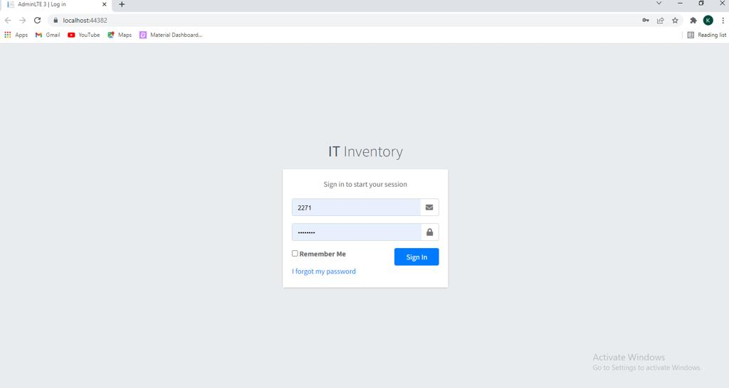
Login Page

Slide 15
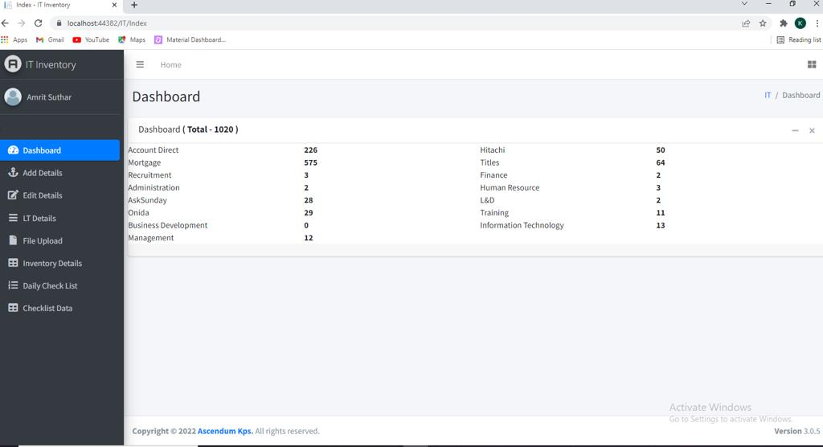
Dashboard

Slide 16
Thank You!

